Slide 1
Historical Legacies: A model linking Africa’s past to its current underdevelopment
By Nathan Nunn

Slide 2
Overview
About: Linking Africa’s current under-development to colonial rule and the slave trade.
Question: Why do they continue to matter today?
Model:
one equilibrium with secure property rights and a high level of production
others with insecure property rights and low levels of production.

Slide 3
Introduction
Africa’s economic performance since independence has been poor due to the slave trade and colonial rule.
Why do these events, which ended years ago, continue to matter today?
The model highlights the effect that colonial rule and the slave trade may have on the security of private property, and as a result, the level of production in the economy.

Slide 4
Model
The model developed has two stages.
First stage: a colonizer chooses a policy that has two instruments: the rate of extraction and the amount of resources to devote towards the enforcement of domestic property rights.
Second stage: focuses on an important determinant of Africa’s poor performance: the widespread presence of robbery, theft, fraud, corruption, and civil conflict
“Productive” and “Unproductive” activities
Core difference: unproductive activities exert a negative externality on those engaged in productive activities, while productive activities do not exert a negative externality.

Slide 5
Explanations
Prior to European contact, many African societies are located in high production equilibrium.
During contact, external extraction lowers the return to productive activities relative to unproductive activities. This causes the high production equilibrium to disappear, leaving a unique low production equilibrium.
Individuals switch from productive activities to unproductive activities, as the society moves to the new equilibrium.
After the period of extraction, the high production equilibrium again exists. However, the society is now trapped in a low production equilibrium. The stability of this suboptimal equilibrium makes moving to the more efficient high production equilibrium difficult.

Slide 6
In the first stage, the colonizer moves, choosing a policy that consists of two instruments.
The first is the rate of extraction .
The second instrument is the amount of resources devoted towards enforcing the security of private property in the society. The cost to the colonizer of a policy that generates q is c(q).
In the second stage, each member of the society chooses whether to engage in productive activities or unproductive activities;
Each individual engaged in productive activities produces the output A.
Denote the fraction of unproductive entrepreneurs by x.
the probability x of an unproductive entrepreneur’s finding a productive entrepreneur can be written: Pr(successful theft) = min(x/1-x,1)

Slide 7
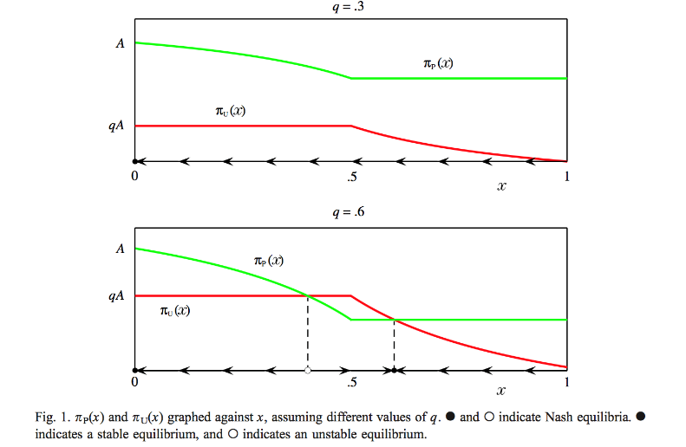
The second stage of the game without extraction, =0, and with the security of property q determined exogenously models pre-contact Africa.
In this environment, payoffs are written as functions of x only: P(x) and U(x).

Slide 8
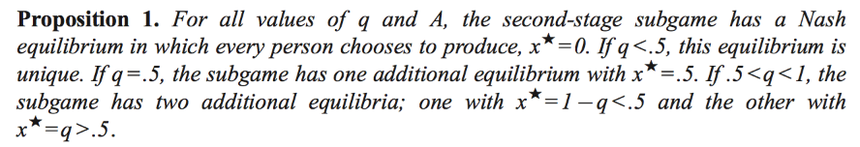
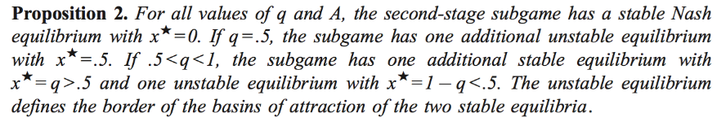
The following proposition describes the set of Nash equilibrium.

Slide 9
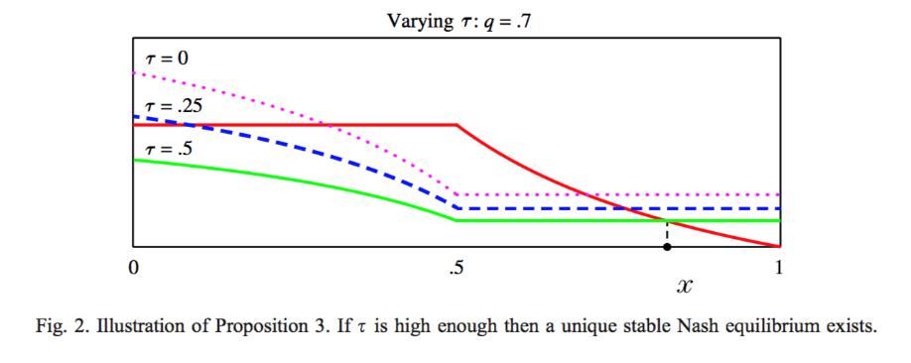

Slide 10
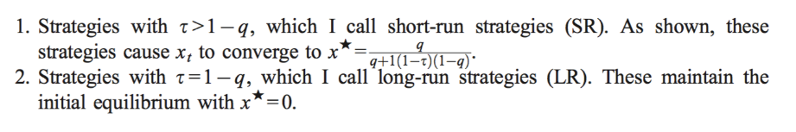
Lemma 1. For every LR strategy, there are SR strategies that yield a higher payoff in at least the first period.
Lemma 2. There exists ̄t sufficiently large, such that the best LR strategy yields higher payoffs in each period tz ̄t than do all SR strategies.

Slide 11
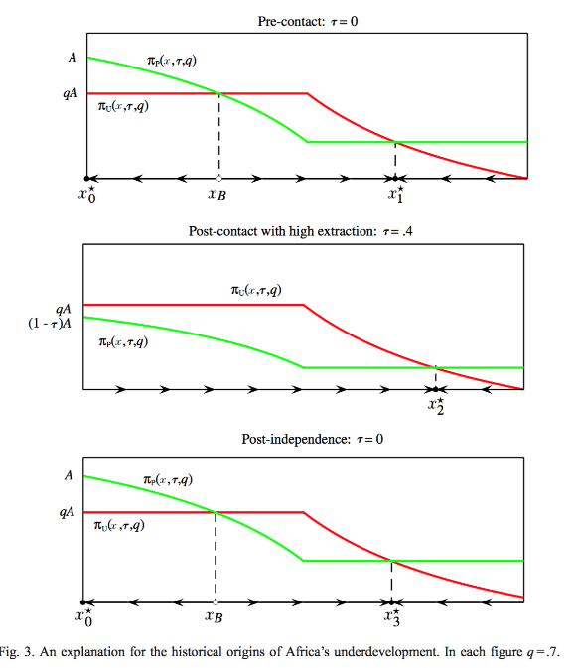

Slide 12
More Explanations
Prior to European contact, many African societies were located in high production equilibrium.
External extraction, during the slave trade and colonial rule, lowered the return to productive activities relative to unproductive activities.
After European contact, the proportion of individuals engaged in unproductive activities increased over time.

Slide 13
Conclusions
Africa’s poor performance can be partially explained by its unique history, which is characterized by two key events: the slave trade and colonial rule.
external extraction, when severe enough, causes a society initially in the high production equilibrium to move to a low production equilibrium.
Because of the stability of low production equilibrium, the society remains trapped in this suboptimal equilibrium even after the period of external extraction ends.

Slide 14
Critique
do not believe that this is the only channel of influence. Many other channels are possible,
For example, do not consider the possible effects of assassinations of indigenous leaders during colonialism, declines in indigenous populations during the slave trade, or the impact of colonial rule on current international economic relations.
An important assumption of the model is that the colonizer is only able to tax entrepreneurs that produce.
Analysis focuses solely on history. do not consider the role expectations play in equilibrium selection.
Assumption: Africa’s history is consistent with each part of the explanation.

